Slide 1
Description of an image using present continuous
For what do you use it?
To describe actions that are occurring at this moment, that is, at the moment in which it is being spoken.

Slide 2
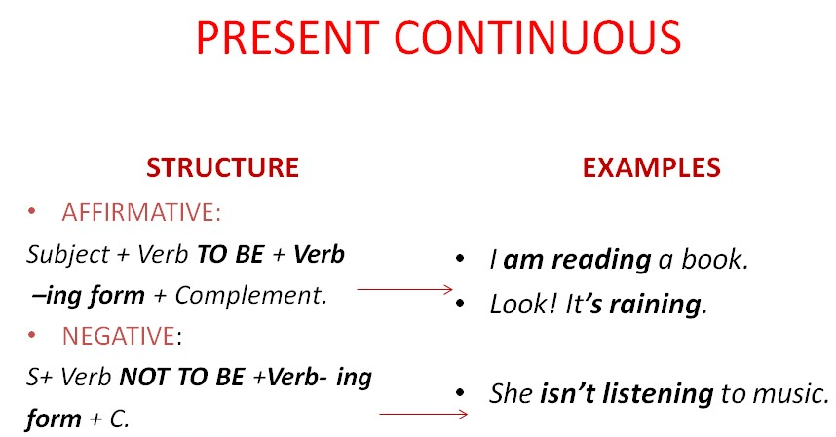
How is it formed?

Slide 3
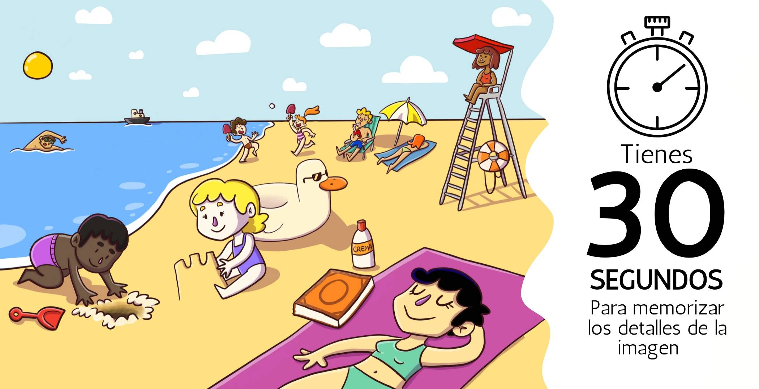

Slide 4
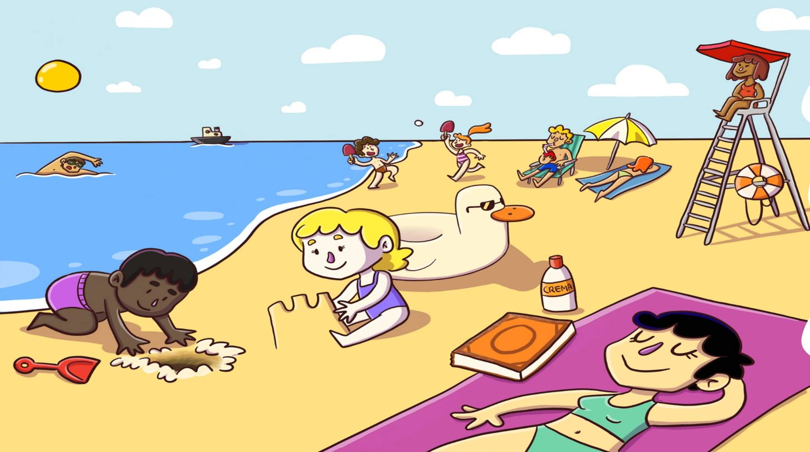
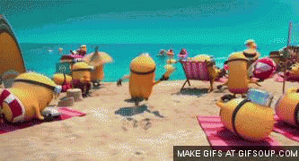
We can see that it is a very sunny morning
The main focus of the image is the people who carry out different activities.
There is a group of people who go out to enjoy the sun
We also see some adults sunbathing and others playing ball

Slide 5

You can see a person swimming on the seashore
In the background there is a ship about to reach its destination
A woman is seen in a blue bathing suit and a purple towel
There is a lifeguard in an orange suit who watches visitors
Next to her there is a couple enjoying the weather

Slide 6

¡THANK YOU!

